Slide 1


MUSCULOSKELETAL ABNORMALITY DETECTION USING DEEP LEARNING
Capstone Project Phase 1
2 Credits

Slide 2
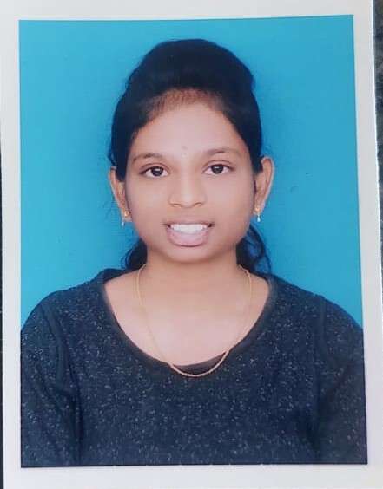
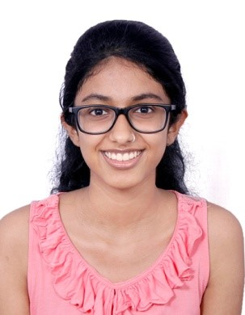
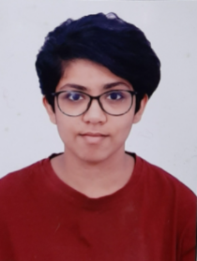
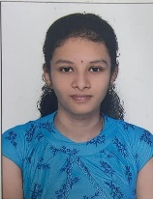
Team Composition
KOTHURU EESHA SOUGANDHEEKA | PES1UG19EC141 | ​ ​
NANDANA HARIKUMAR | PES1UG19EC176 | ​
​NIHARIKA GOWRI RAGHUNATH | PES1UG19EC184 | ​ ​ ​
PALADI NAVYA SREE | PES1UG19EC​192 ​ | ​ ​ ​
Guide : Prof. H.R. Vanamala

Slide 3
Contents
Introduction
Problem Statement
Methodology
Motivation
Block Diagram
Working Principle
Deliverables
Literature Survey
Project timeline Gantt Chart

Slide 4
Introduction
Musculoskeletal disorders are conditions that
affects joints, bones, muscles, and the spine.
Increasing radiologist workloads and increasing primary care, radiology services make it relevant to explore the use of artificial intelligence (AI) and particularly deep learning to provide diagnostic assistance to radiologists.

Slide 5
Problem Statement
To investigate new model architectures to improve the performance in detecting abnormalities of upper extremities (specifically, shoulders) in limited data environments and allow them to serve as initial analysis tools to prioritize studies for expedited review.

Slide 6
Proposed methodologies
Efficient Nets
CADx model using Ensemble learning
Key Area Localization Mechanism(KALM)
DenseNet-169,DenseNet-201
Capsule Network
AlexNet,ResNet,GoogLeNet

Slide 7
Motivation
Global Burden of Disease (GBD) conducted a study in 2016, found that musculoskeletal abnormalities were the second highest exploiter to global disability.
Around 20%-30% people worldwide live with tormenting musculoskeletal abnormalities.

Slide 8
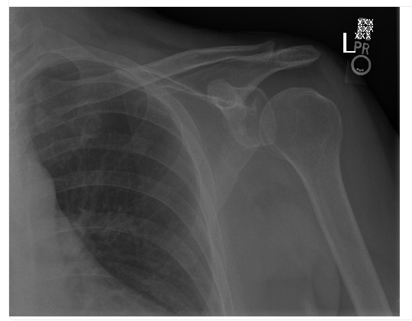
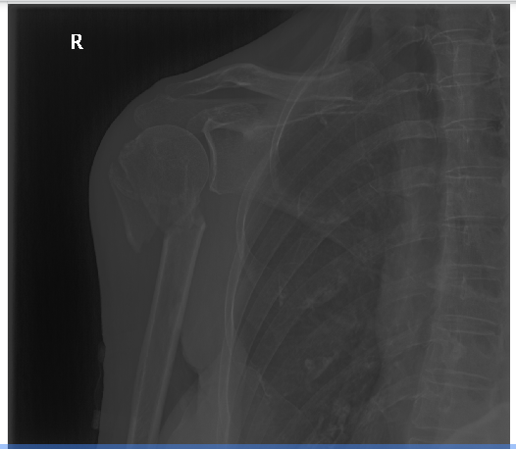
Block diagram
Normal Shoulder X-ray
MURA dataset
Pre - processing
DL model
Binary Classification
Abnormal
Shoulder X-ray

Slide 9
Brief Working Principle
Using the publicly available MURA dataset, we test the performance of existing models specifically for shoulder radiographs.
Upon analysing the performance, we will conclude on how to improve the operation of the model.

Slide 10
Deliverables
A more efficient model for classification of abnormality in Shoulder radiographs by comparing different models using different parameters (such as accuracy and reliability).

Slide 11
References
[1] A. F. M. Saif, C. Shahnaz, W. Zhu and M. O. Ahmad, "Abnormality Detection in Musculoskeletal Radiographs Using Capsule Network," in IEEE Access, vol. 7.
[2] I. Irmakci, S. M. Anwar, D. A. Torigian and U. Bagci, "Deep Learning for Musculoskeletal Image Analysis," 2019 53rd Asilomar Conference on Signals, Systems, and Computers, 2019.
[3] O. Pelka, F. Nensa and C. M. Friedrich, "Branding - Fusion of Meta Data and Musculoskeletal Radiographs for Multi-Modal Diagnostic Recognition," 2019 IEEE/CVF International Conference on Computer Vision Workshop (ICCVW), 2019..

Slide 12
References
[4] S. Madan, S. Kesharwani, K. V. S. Akhil, B. S, B. K P and R. K. M, "Abnormality Detection in Humerus Bone Radiographs Using DenseNet," 2021 Innovations in Power and Advanced Computing Technologies (i-PACT), 2021.
[5] S. Madan, S. Kesharwani, K. V. S. Akhil, B. S, B. K P and R. K. M, "Abnormality Detection in Humerus Bone Radiographs Using DenseNet," 2021 Innovations in Power and Advanced Computing Technologies (i-PACT), 2021..

Slide 13
References
[6] K. Teeyapan, "Abnormality Detection in Musculoskeletal Radiographs using EfficientNets," 2020 24th International Computer Science and Engineering Conference (ICSEC), 2020.
[7] Rajpurkar, Pranav, et al. "Mura: Large dataset for abnormality detection in musculoskeletal radiographs." arXiv preprint arXiv:1712.06957 (2017).

Slide 14
References
[8] W. Huang, Z. Xiong, Q. Wang and X. Li, "KALM: Key Area Localization Mechanism for Abnormality Detection in Musculoskeletal Radiographs," ICASSP 2020 - 2020 IEEE International Conference on Acoustics, Speech and Signal Processing (ICASSP), 2020.
[9] T. C. Mondol, H. Iqbal and M. Hashem, "Deep CNN-Based Ensemble CADx Model for Musculoskeletal Abnormality Detection from Radiographs," 2019 5th International Conference on Advances in Electrical Engineering (ICAEE), 2019.

Slide 15
Literature Survey
Title | Author | Published on | Work | Method | Dataset | Result | Limitation
Abnormality Detection in Humerus Bone Radiographs using DenseNet | Saksham Madan,Sudhansh Kersharwani,K Venkata Sai Akhil,Balaji S,Bharath K P,Rajesh Kumar M | 27-29 Nov.2021 | Identify the large data as abnormal or normal using the DenseNet-169 architecture after pre-processing . | 169-layer DenseNet | MURA | On testing the proposed model ,Cohens Kappa score was about 0.680 and accuracy is around 84.028% | Other sections of the dataset such as wrist,elbow etc can also be included for the proposed model
Deep Learning for Musculoskeletal Image Analysis | Ismail Irmarkci,Syed Muhammad Anwar,Drew A.Torigian,Ulas Bagci | 3-6 Nov.2019 | Using CNN based architectures, comparatively evaluated the knee abnormality classification performances of different neural network architectures | AlextNet, ResNet-18, and GoogLeNet | MRI images from MRNet | On an average (for all three classes), the AUC was 0.8787, 0.8579, and 0.8596 for AlexNet, ResNet18, and GoogLeNet, respectively. The highest accuracy for abnormality was 85.83% using AlexNet, 86.67% for ACL using ResNet-18, and 75.83% using both AlexNet and ResNet18 architectures. In general, ResNet-18 out-performed AlexNet and GoogLeNet in all performance parameters except in specificity (0.6908). | Other architectures can be included for analysis.

Slide 16
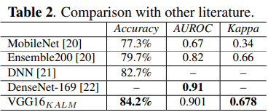
Abnormality Detection in Musculoskeletal Radiographs Using Capsule Network | A. F. M. Saif, Celia Shahnaz, Wei-Ping Zhu and M. O. Ahmad | June 14, 2019 | Finding abnormality in musculoskeletal radiographs is a very difficult task and if automatic detection of abnormality can be introduced, it would be very helpful for further diagnosis and Treatment. In this paper, a capsule network is designed to classify normal and abnormal condition and compared the result with densenet architecture | Capsule network | MURA | The proposed capsnet architecture provides almost 10% better kappa score than the 169 layers of densenet while using 50% less training data. | As capsule network is a very recent idea, it has been used in very limited areas like classification problem.
KALM: Key Area Localization Mechanism for Abnormality Detection in Musculoskeletal Radiographs | Wei Huang, Zhitong Xiong, Qi Wang and Xuelong Li | 8 May 2020 | Proposed a key area localization mechanism (KALM) for abnormality detection. | Key area Localization Mechanism | MURA |  | KALM was first time proposed in this paper further improvements can be done using this method

Slide 17
Deep CNN-Based Ensemble CADx Model for Musculoskeletal Abnormality Detection from Radiographs | Tusher Chandra Mondol,Hasib Iqbal,MMA Hashem | 26-28 Sept.2019 | Develop a novel Computer-Aided Diagnosis(CADx) system based on Deep Convolutional Neural Network (Deep CNN) that will help the doctors to identify musculoskeletal abnormalities through radiographs | VGG-19,ResNet architecture to build a model for four types of study (Elbow, Wrist, Finger, and Humerus). 5-fold cross-validation method is also applied to evaluate our models and ensemble techniques to improve the model's performance. | MURA | Elbow, Finger, Humerus, Wrist study, model performance was consecutively 86.45%, 82.13%, 87.15%, and 87.86%. | 1.Contrast Limited Adaptive Histogram Equalization (CLAHE) can be used instead of Histogram Equalization (HE) to enhance the radiographs. .
Machine Learning Models for Abnormality Detection in Musculoskeletal Radiographs | P rajpurkar, J Irvin et al. | 11 Dec 2017 |  | 169-layer DenseNet baseline mode | MURA | Model performance is comparable to the best radiologist performance in detecting abnormalities on finger and wrist studies. | Model performance is lower than best radiologist performance in detecting abnormalities on elbow, forearm, hand, humerus, and shoulder studies.

Slide 18
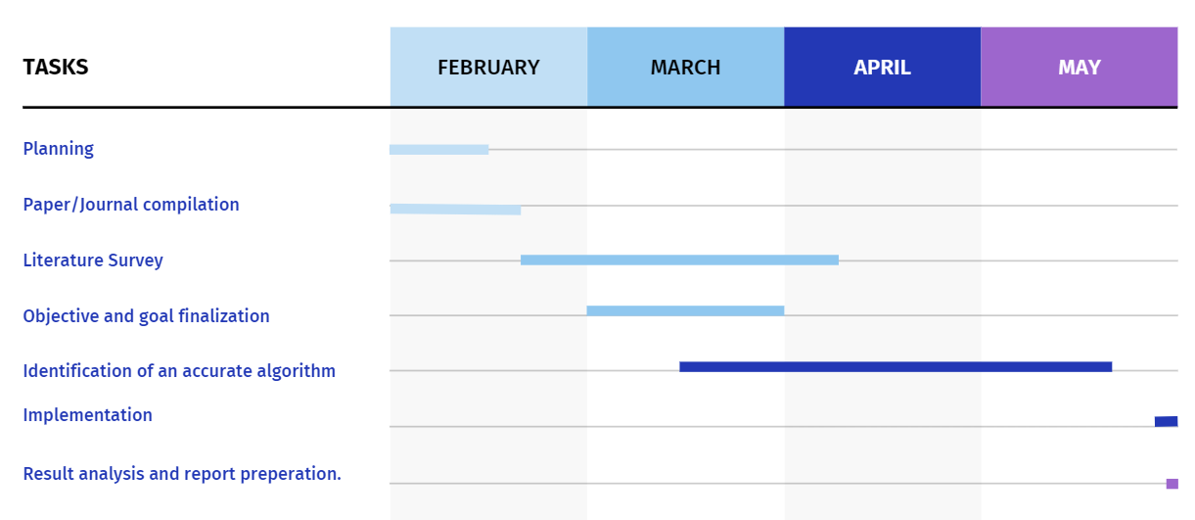
Project timeline

Slide 19
Q & A

Slide 20
Thank You

